Slide 1
Modeling and Simulation of a vaccination center.
DEVS Model using Cadmium
S M Abu Adnan Abir
Student # 101244043

Slide 2
Background Motivation

Slide 3
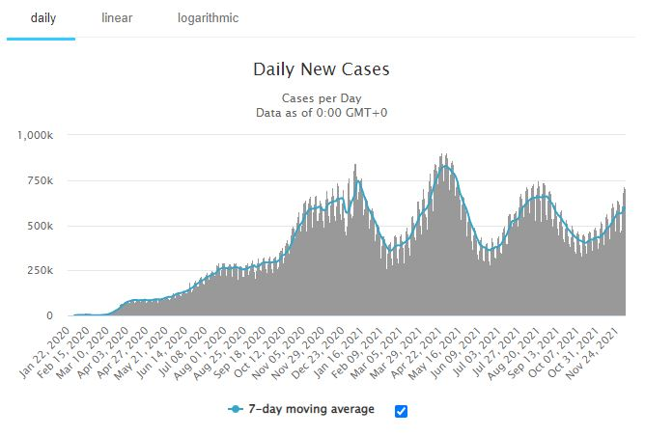
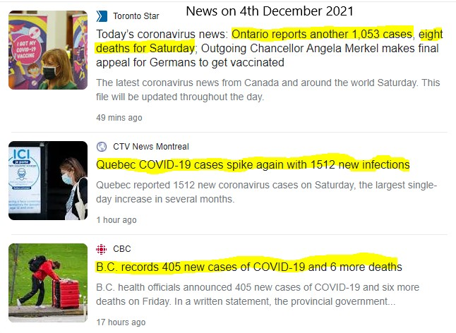
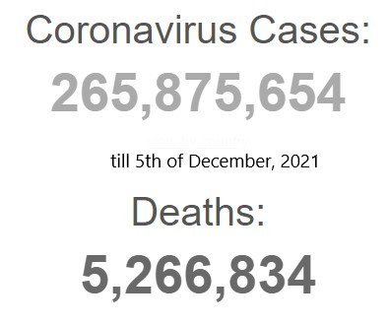
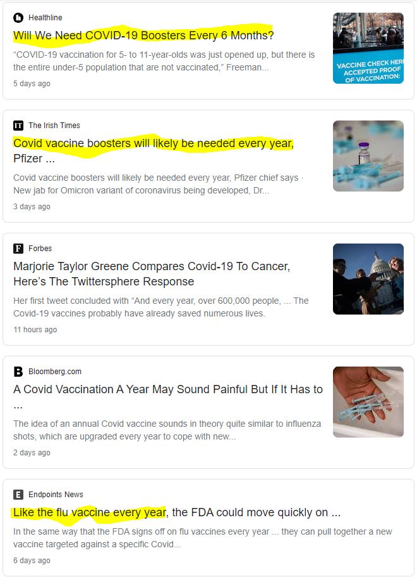
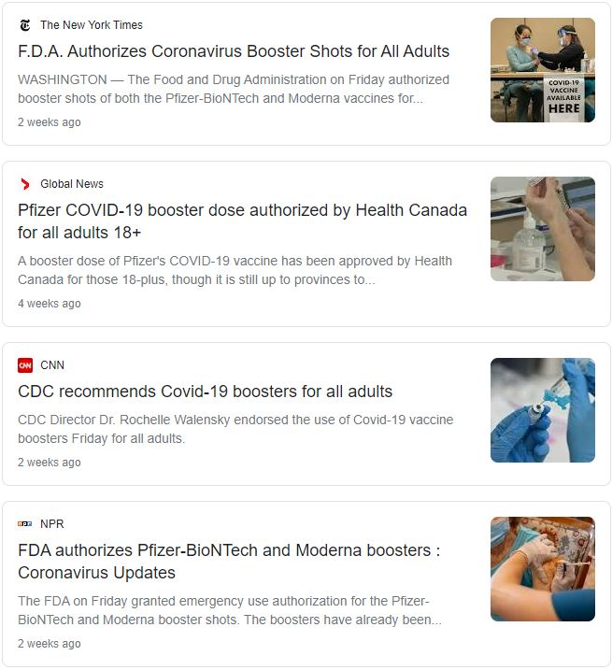
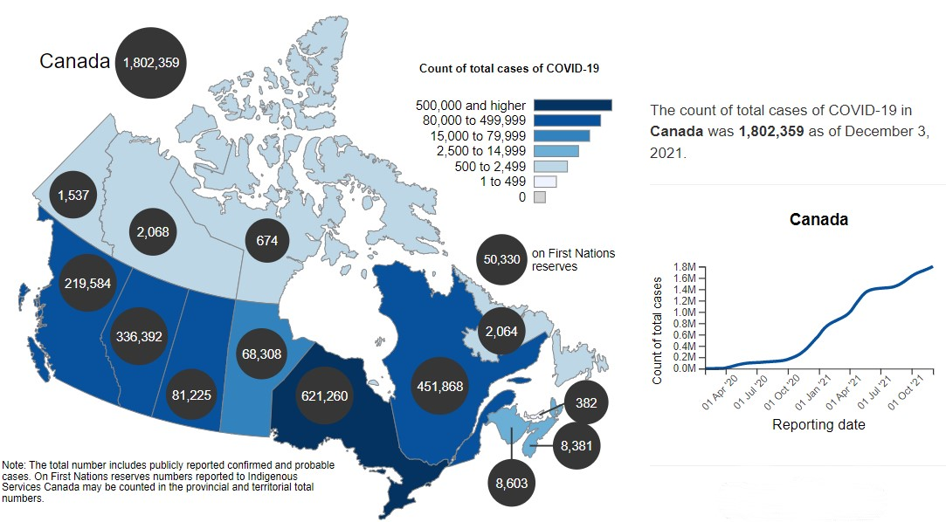
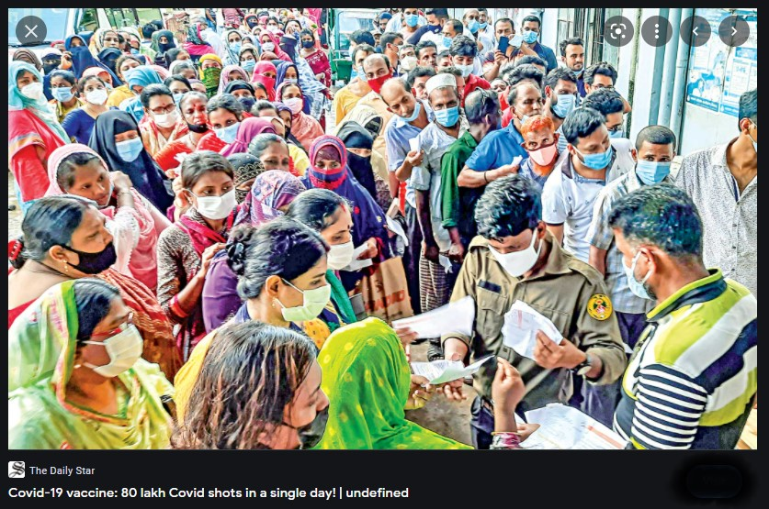
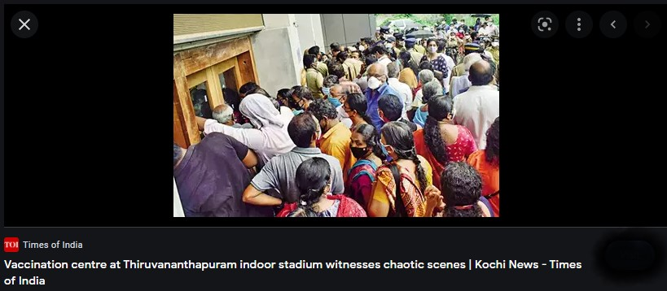
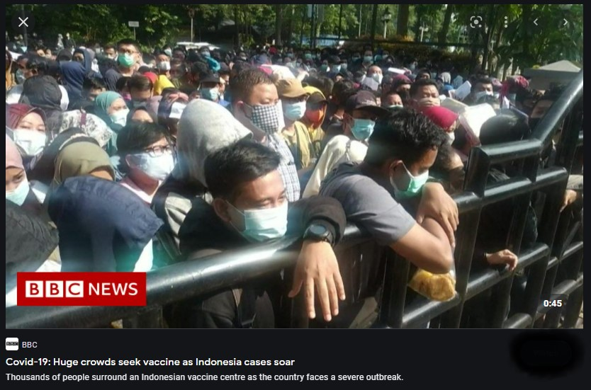
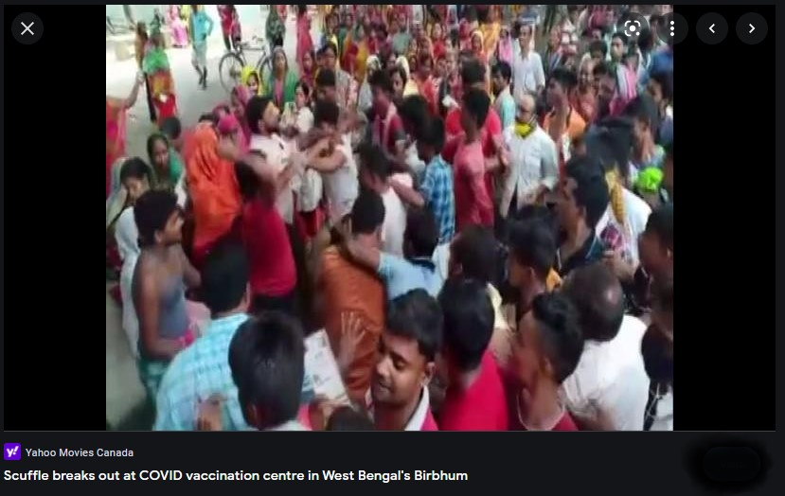
Background Motivation
Present pandemic situation forced us to rethink about our traditional vaccination process and enforced us to rearrange the vaccination center set-up in a way to serve huge number of people within a short period of time.
Rise in daily new cases are reported

Slide 4
Background Motivation
Present pandemic situation forced us to rethink about our traditional vaccination process and enforced us to rearrange the vaccination center set-up in a way to serve huge number of people within a short period of time.
Authorities are recommended for booster dose, which likely to be needed annually like the flu vaccine

Slide 5
Background Motivation
Present pandemic situation forced us to rethink about our traditional vaccination process and enforced us to rearrange the vaccination center set-up in a way to serve huge number of people within a short period of time.
Highly populated countries required effective vaccination process that can serve huge population within a short time

Slide 6
Background Motivation
Present pandemic situation forced us to rethink about our traditional vaccination process and enforced us to rearrange the vaccination center set-ups in a way to serve huge number of people within a short period of time.

Slide 7
Model definition

Slide 8
If no, go to registration desk
People enter the center in this way
Are you registered?
yes
If yes, go this way
Queue will add new entry if the desk is busy till the queue is full

Slide 9
Queue will add new entry if the desk is busy till the queue is full
Registration process will be completed, and new registration number will be given
Registered person will be added to the queue
Are you registered?
yes
Go this way

Slide 10

Vaccination is done, people will leave this way
Vaccine will be pushed here
new entry will be added to the waiting area if the pushing counter is busy till the area is full

Slide 11
Simulation/ Experiment with the model

Slide 12
Block diagram of vaccination center, Coupled model and atomic model for testing

Slide 13
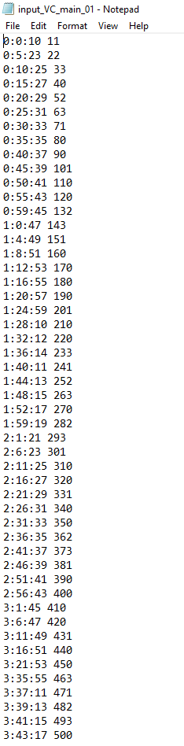
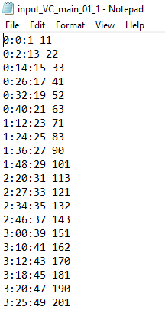
Experimental setup
Experiment was done with 20 and 50 sets of input data.
Non-registered entry has zero value at their last digit.
Registered entry has 1 or 2 or 3 at last digit.
Registration desk randomly add a digit from 1,2,3 at the last digit.

Slide 14
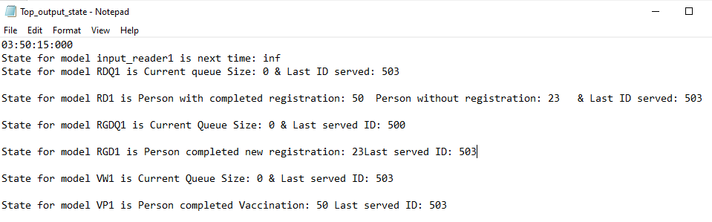
Experimental result
No. of entry in this simulation is 50
Last entry ID is 500
No. of entry completed new registration is 23 ( entry with zero at last digit)
No. of person completed vaccination is 50.
Last entry served is with ID 503

Slide 15
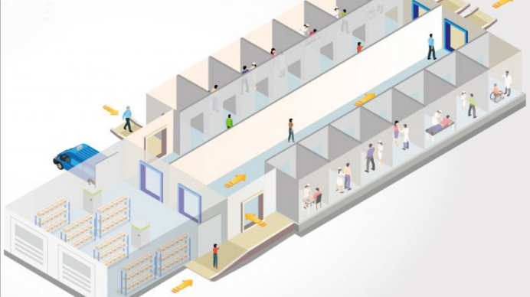
Conclusion
So far, we got expected output from 20, 50 input data. We want simulate the model with 1000 or more data to make it more realistic.
We want to add new atomic models such as different pushing counter for different type of vaccine and run the simulation.

Slide 16
Question?

